Slide 1
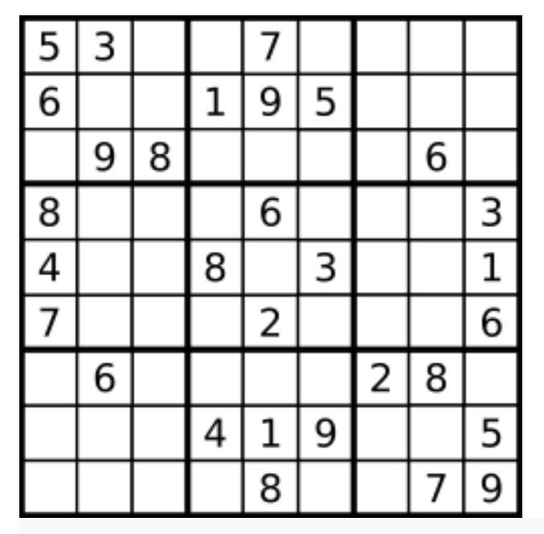
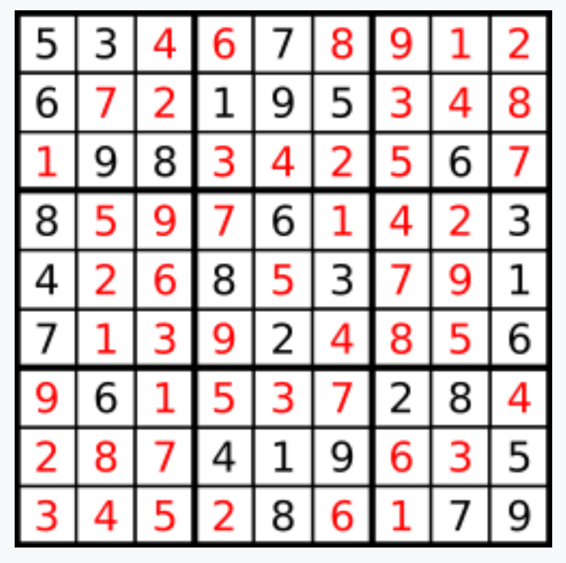
37. Sudoku Solver
→
Notes:
For this project I choose Sudoku Solver problem. Do you guys know what is a sudoku puzzle?
At the beginning we given a 9x9 field with some numbers, and the task is to fill all the empty cells.

Slide 2
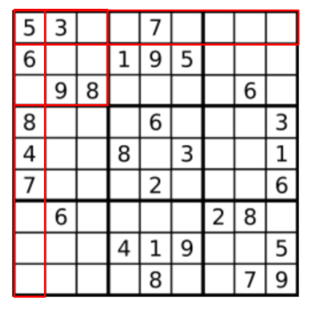
Number’s 1 – 9 occur exactly once in every
row
column
3x3 sub-box
Write an algorithm to solve a Sudoku puzzle by filling the empty cells.
Notes:
There are few rules.
We can only insert numbers one though nine exactly once in every row, column, and 3x3 sub-box.
And the assignment is to write an algorithm to solve this puzzle.

Slide 3
Approach 1: Brute-Force
try every possible number 1-9 to every empty cell to generate every possible board
validate all board to find the correct one
but well-formed Sudoku board has only one solution
Approach 2: Backtracking
Two concepts that can help
- constrained programing
- backtracking
Notes:
There are 2 main approaches to write this algorithm:
brute-force
backtracking
For brute-force
We could try every possible assignment between 1 and 9 to every empty cell to generate every possible board that we can.
Then at the end validate if the sudoku board is valid or not. This will give us exponential amount of board that we need to create and then validate.
But, for the well-formed Sudoku board there is going to be only one solution.
Therefore, we do not want to create and validate an exponential number of boards to choose only one valid board because it would take too long.
The 2nd approach is backtracking.
For this approach we need to concepts : - constrained programing and backtracking

Slide 4
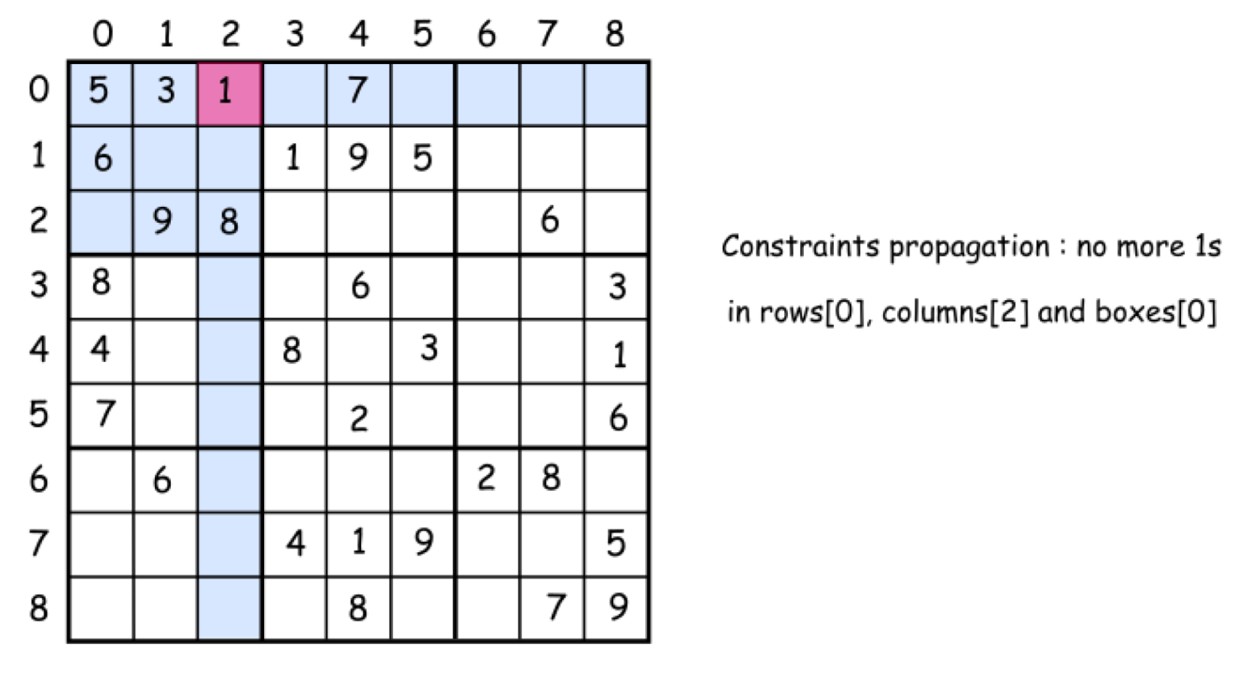
Constrained programing
Put restrictions after each number placement
- immediately exclude this number from further usage in the current row, column, and sub-box
Helps to reduce the number of combination to consider for the next empty cell
Notes:
Constrained programing puts restrictions after each number placement. After putting a number on the board and the immediately will exclude this number from further usage in the current row, column, and sub-box. That propagates constraints and helps to reduce the number of combinations to consider.
But the important thing for this approach is every time before placing a number in the cell we need to make sure that it won’t break the sudoku. For example, before placing this 1 on the board we need to check if it is a valid placement.
However, at some point there might be a situation like this -> next slide

Slide 5
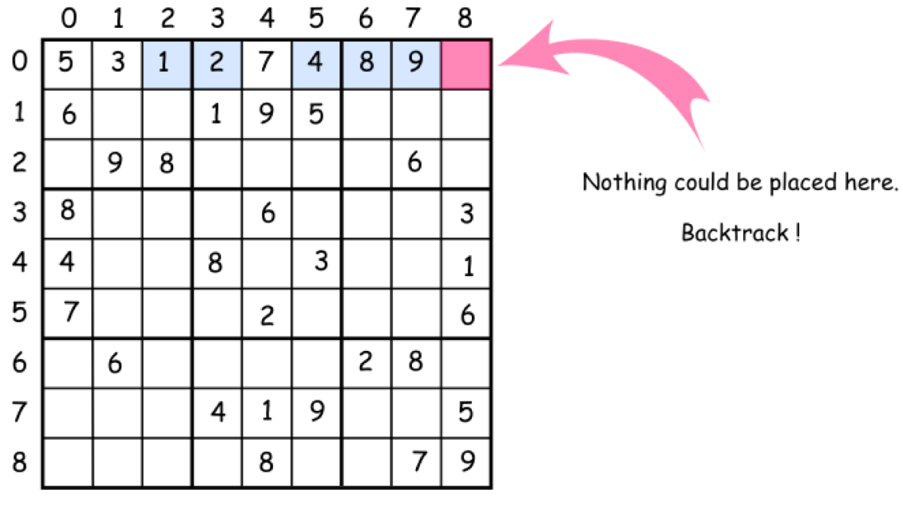
Backtracking
Notes:
When we put several numbers on the board, but at some point, we cannot go any further because we cannot find a valid number to place. That means that the combination chosen is not the optimal one and we need to backtrack.
That means to come back, to change the previously placed numbers and try to procced again. If that would not work either, we need to backtrack again.

Slide 6
Pseudocode
Start from the upper left cell [row=0][column=0]. Proceed until the first empty cell.
Iterate over the number from 1 to 9 and try to put each number c in the [row][column] cell.
If number c is not yet in the current row, column, and box:
Place the c in a [row][column] cell
Proceed to place further numbers.
If we inserted the last number [row=8][column=8] successfully, we solved sudoku.
Backtrack if the solution is not yet here: remove the last number from the [row][column] cell.

Slide 7
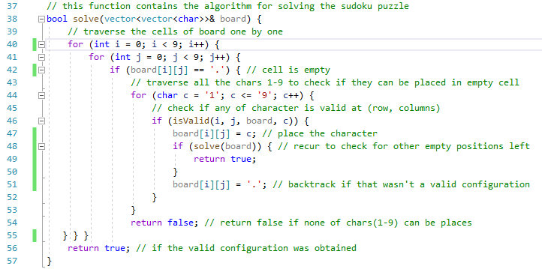
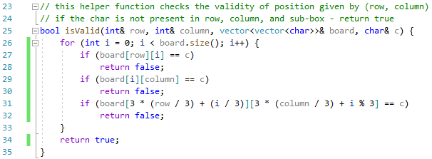

Slide 8
Complexity Analysis
Time complexity:
O(9^(n*n) For every empty index there are 9 possible options.
Space complexity:
O(n*n) To store the output vector a matrix is needed.

